Slide 1


Deep RL for StarCraft II
Group 27
Advisors: Mu Lisen, Liu Jingchu
Notes:
各位老师同学，大家好。我是来自27组的刘明桓，我今天要讲的是，DeepRL与星际争霸

Slide 2
Contents
1
Overview
2
Previous Works
3
Our Work
4
Future Work
5
Conclusion
6
Benefit in RL Practice
Notes:
今天的内容我将从这五个方面对我们的工作进行一个梳理。

Slide 3
Overview
Reinforcement Learning
Why StarCraft II
Introduction to Minigames
Notes:
首先，我将简单介绍一下强化学习和星际争霸

Slide 4
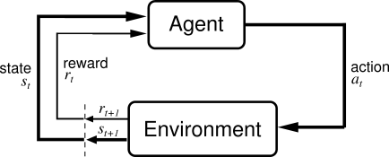
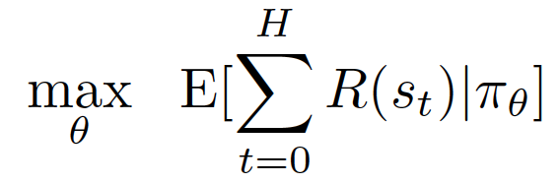
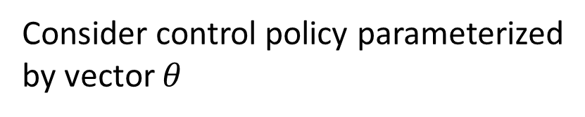
Reinforcement Learning
Consider control policy parameterized
by vector $θ$
Deep Learning + Reinforcement Learning = Deep RL
Notes:
首先用一个简单的图示描述强化学习。智能体agent从环境中获得一组观测observation，然后选择合适的动作action执行，在环境中执行的结果获得汇报reward。agent与环境不断交互，最终学习到最优策略，以获取最大的累积回报。
Deep learning和reinforcement learning结合后产生了众多的Deep RL方法。

Slide 5
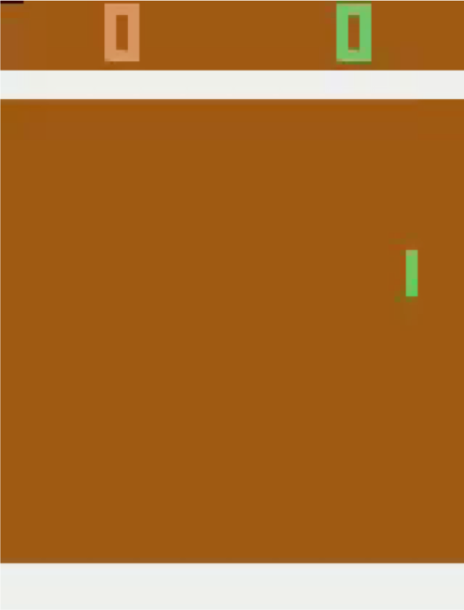
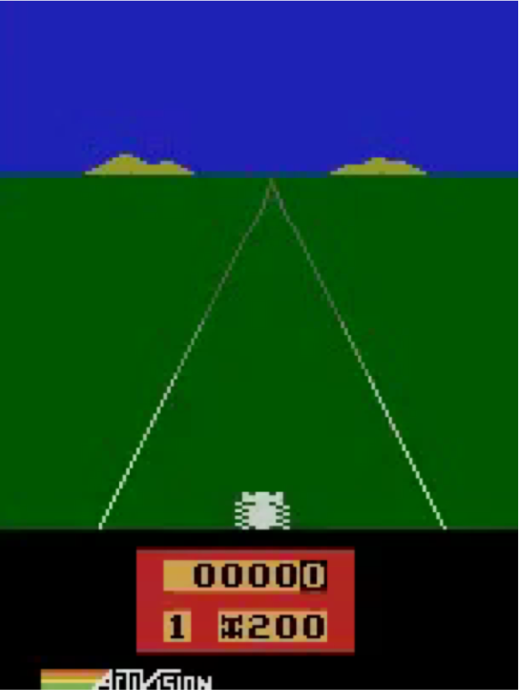
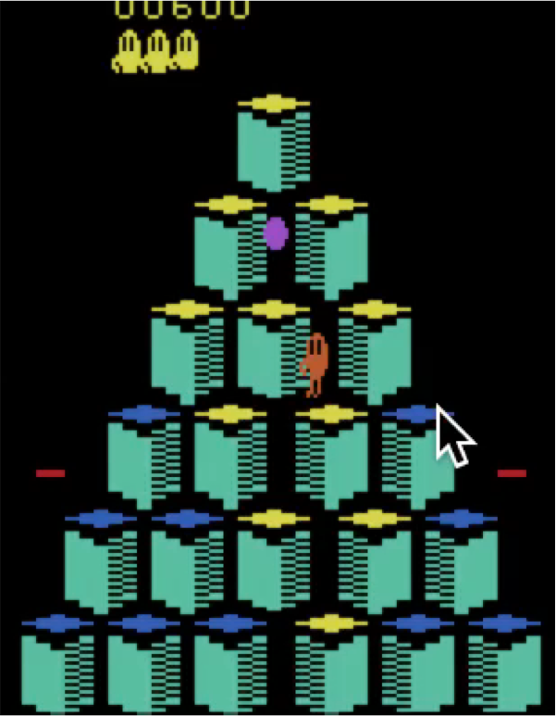
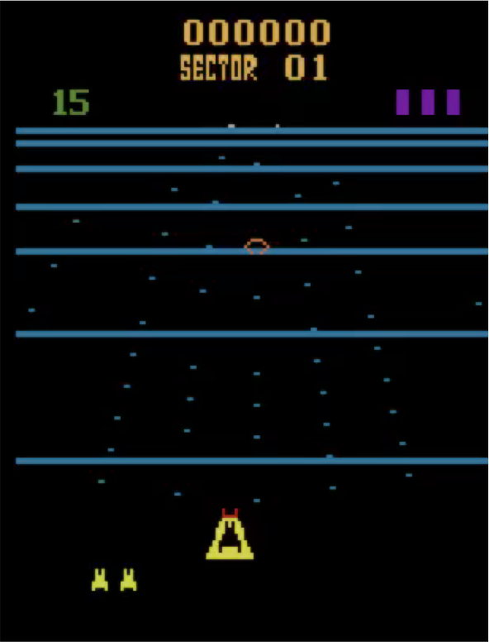
Deep RL Success Stories
Atari Games
DQN Mnih et al, NIPS 2013 / Nature 2015
MCTS Guo et al, NIPS 2014; TRPO Schulman, Levine, Moritz, Jordan, Abbeel, ICML 2015; A3C Mnih et al, ICML 2016; Dueling DQN Wang et al ICML 2016; Double DQN van Hasselt et al, AAAI 2016; Prioritized Experience Replay Schaul et al, ICLR 2016; Bootstrapped DQN Osband et al, 2016; Q-Ensembles Chen et al, 2017; Rainbow Hessel et al, 2017; Accelerated Stooke and Abbeel, 2018; …
Slide credit: Pieter Abbeel
Notes:
利用Deep RL，Deepmind已经教会了AI玩游戏，并在Atari Game中取得了超越人类表现的结果；

Slide 6
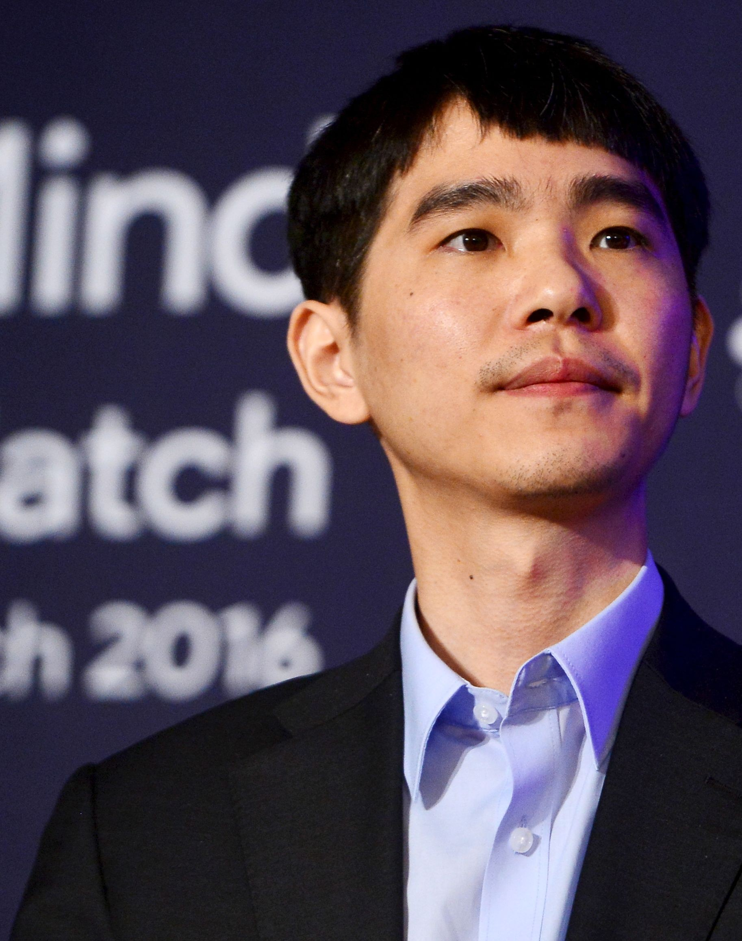
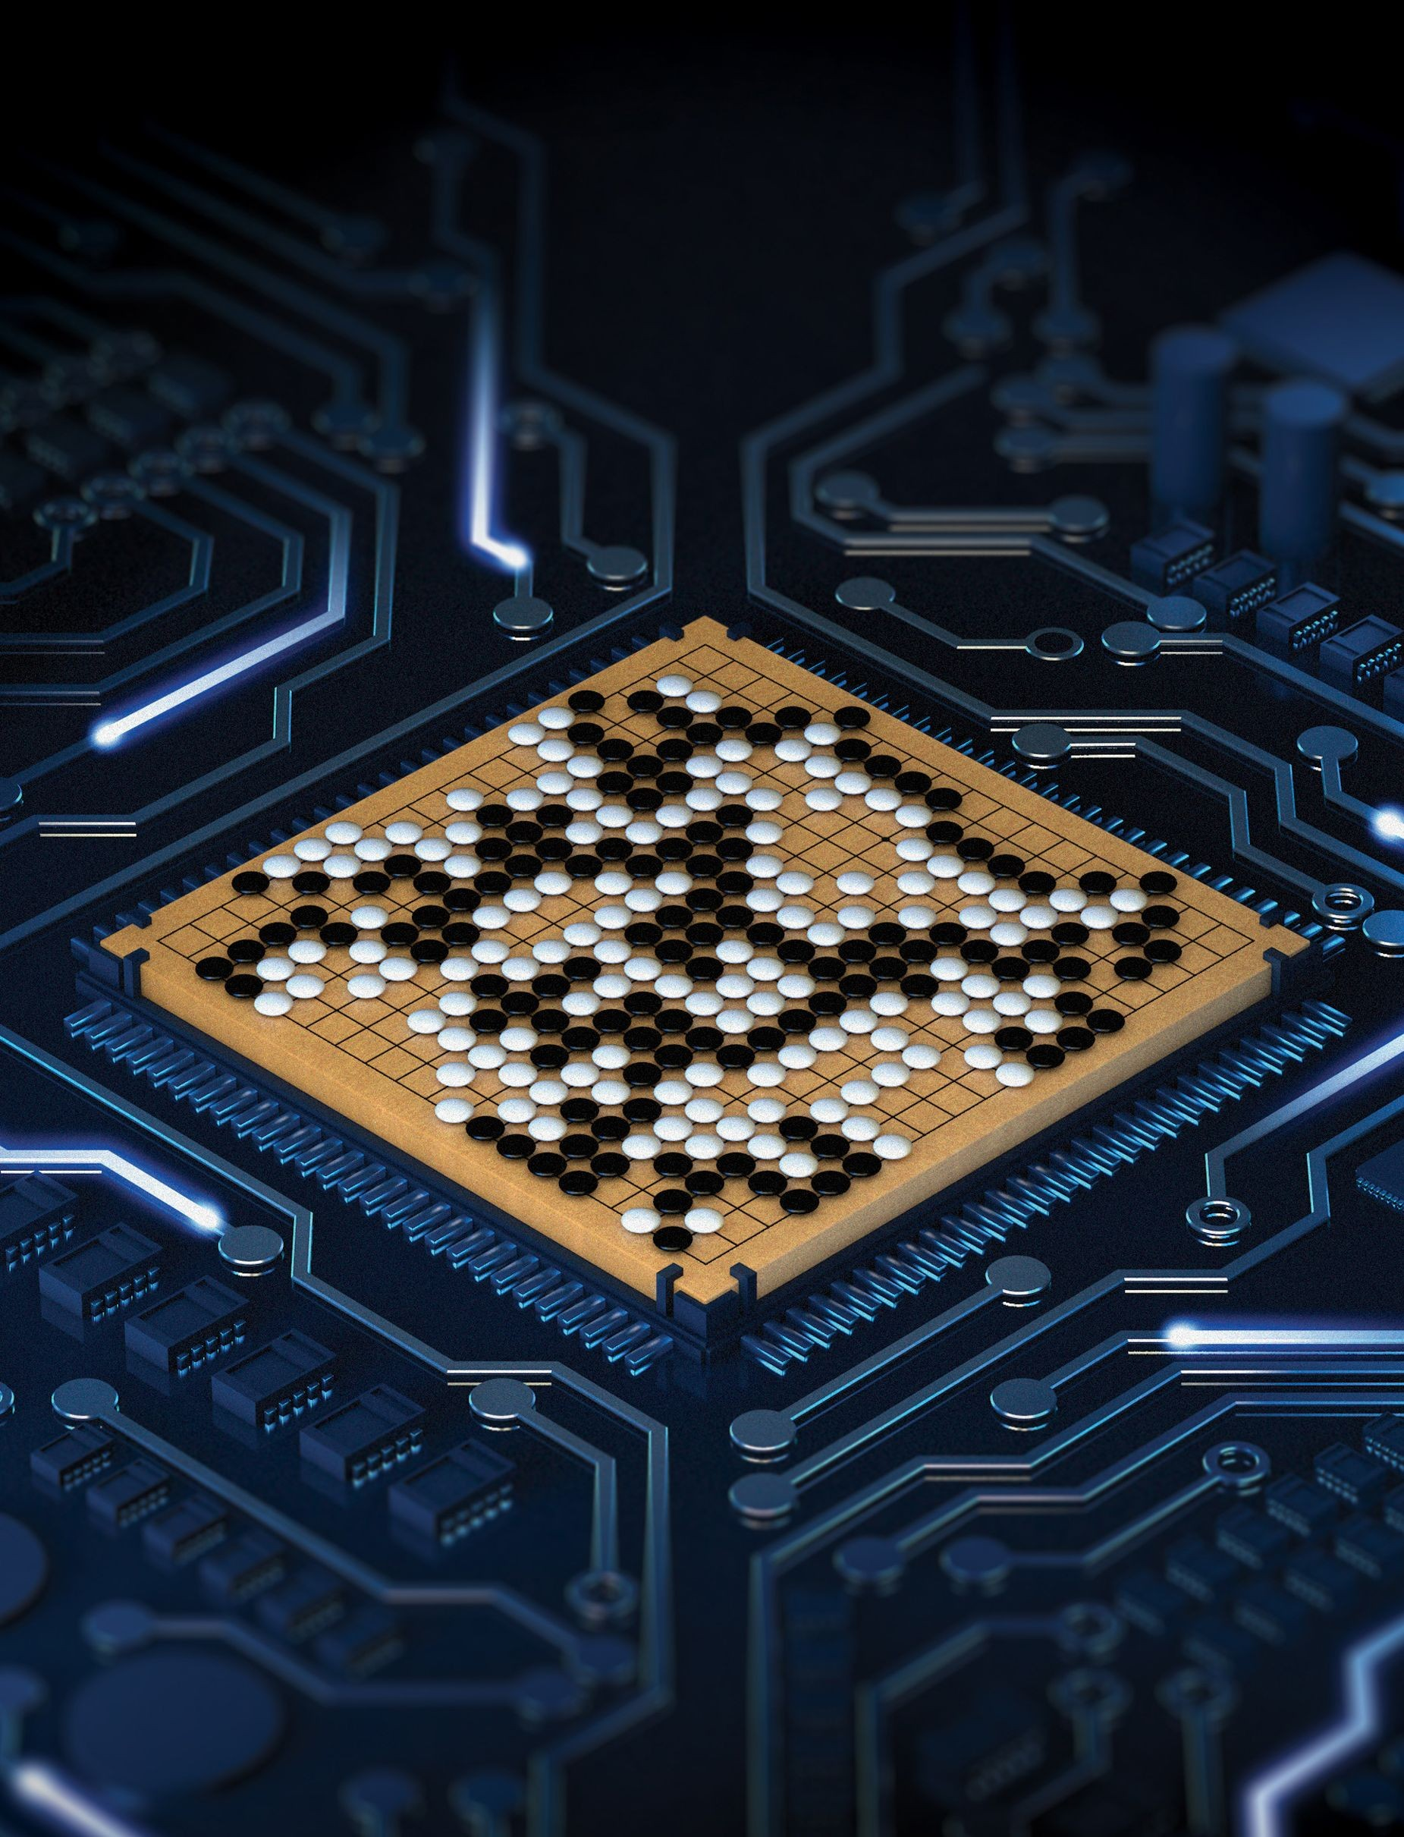
Deep RL Success Stories
Vs
Lee Sedol
AlphaGo
AlphaGo Silver et al, Nature 2015
AlphaGoZero Silver et al, Nature 2017
AlphaZero Silver et al, 2017
Tian et al, 2016; Maddison et al, 2014; Clark et al, 2015
Notes:
而此后几年的Alpha Go，也几乎在围棋中彻底超越了人类；

Slide 7

Deep RL Success Stories
OpenAI, 2018
Notes:
而早早将Dota2作为研究重点的OpenAI也在前几天碾压了职业选手。那么，我们为什么还要拿星际争霸2作为强化学习的练兵场呢。

Slide 8
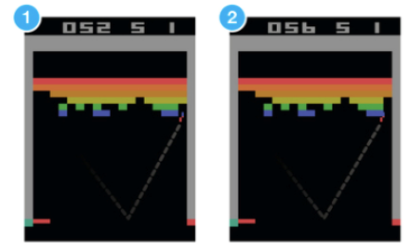
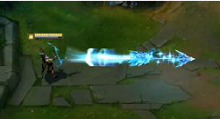

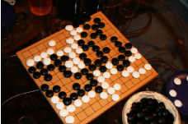

Why StarCraft II?
Artificial general intelligence
AGI
More difficult and close to the real scenes
Rich streams of observable data
Simulations can be run at scale
Clear objective of success
Notes:
大家都看到，OpenAi和Deepmind这两大AI巨头都将游戏作为迈向通用人工智能的必经之路。与围棋相比，它更复杂，也更接近真实情况；作为游戏，它可以提供丰富的数据并能进行大规模的训练；并且，它们都有明确的胜利目标。

Slide 9
Why StarCraft II?
Imperfect Information
Real-Time
01
04
simultaneous, fast paced decisions
multi-tasking
guess what the opponent is doing
Huge Action Space
05
Long Pay-Off
02
need for hierarchical actions
strategy more important than micro
Economy System
06
3 Asymmetric Races
03
resource management, expanding vs. defence
each with their own strengths and weaknesses
Notes:
和Dota2相比，星际争霸的单位更多，决策空间更大，任务也更难。我们获取不到全部的对手信息，并且动作空间巨大；我们需要根据我们的经济来决策资源的采集和扩张与防御，进行多任务的实时决策；此外，游戏的回报是win/lose reward，通常需要到游戏结束才能获得；星际争霸2的3个种族各有利弊，因此可选择性更广。

Slide 10
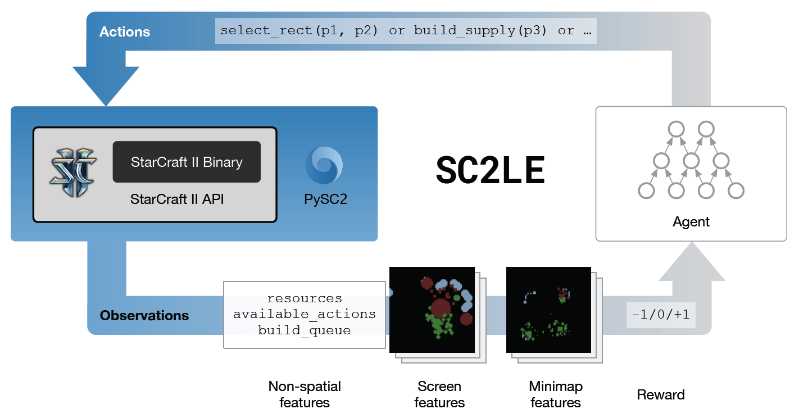


Why StarCraft II?
StarCraft II learning environment
Notes:
因此，Deepmind与暴雪合作共同推出了星际争霸2的学习环境和pysc2接口，提供了一系列API可供我们在星际争霸的环境中进行学习，研究。

Slide 11
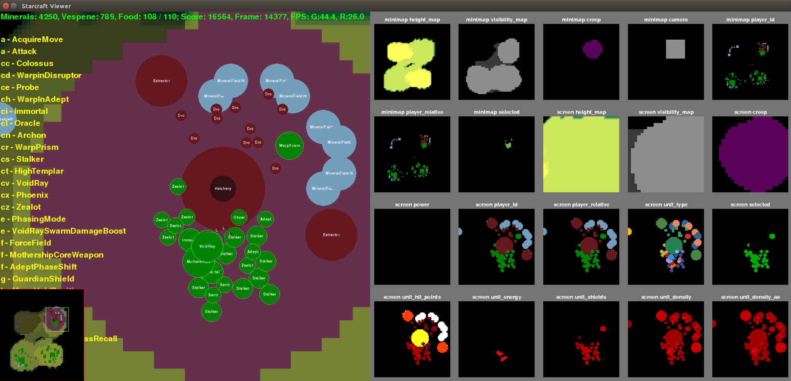
Notes:
我们可以看到在这里，pysc2给我们提供了一系列的feature map。screen信息和minimap信息，除了这些可视化信息，还包括很多非可视化的结构信息。

Slide 12
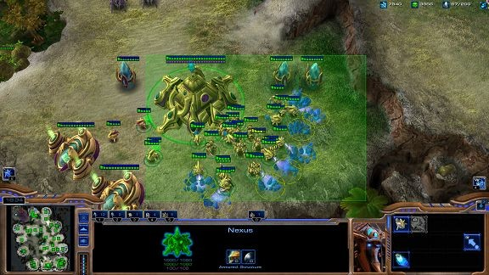
Notes:
说到这，大家可能以为我们会直接像OPEN AI一样，做出一个可以在对战full game中轻松战胜人类的游戏AI。但是遗憾的告诉大家，由于游戏场景比较复杂，目前并没有取得太好的效果。

Slide 13
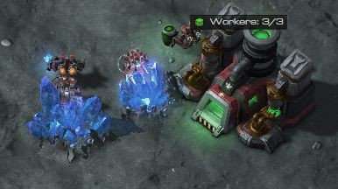
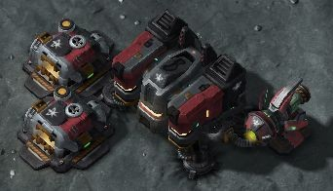
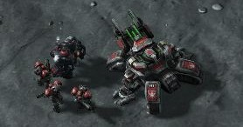
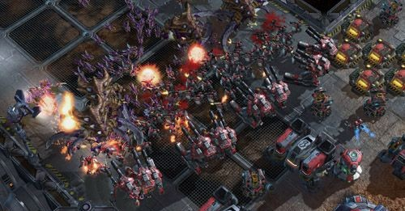
1. Collect resources
2. Build a base
3. Build some units
4. Engage the opponent
Notes:
但是我们可以发行，星际实际上是由一系列的子任务构成。比如，采集资源，建造建筑，训练单位，攻击敌人等等。那么，我们是不是可以从子任务开始学习呢？

Slide 14
Why Start from Minigames?
Learning to play the full game is hard: start with minigames!
Easier reward: points for subgoals, instead of pure win/lose
Fixed time limit (usually)
Deepmind and Blizzard released 7 minigames
Notes:
因此，Deepmind和暴雪推出了一些minigame作为full game的子任务进行学习。Minigame通常是要在限定的时间内来获得更高分数的小任务。他们的reward更简单，也更容易学习。

Slide 15
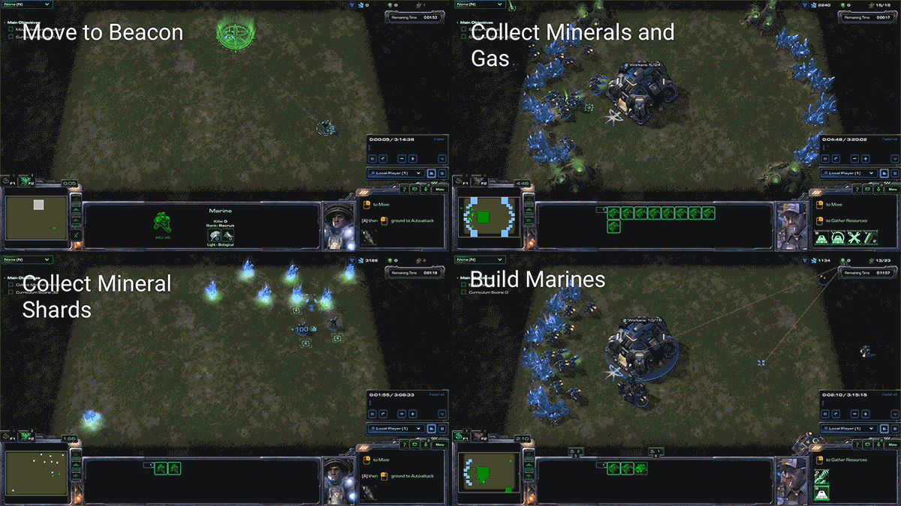
Mini Games
MoveToBeacon
CollectMineralShards
FindAndDefeatZerglings
DefeatRoaches
DefeatZerglingsAndBanelings
CollectMineralsAndGas
BuildMarines
Notes:
这就是7个minigame。以第一个为例，

Slide 16
Previous Works
Deepmind Method & Results
Other Methods & Results
Notes:
Deepmind除了给出了相关的开源研究环境，也提出了一些baseline方法

Slide 17
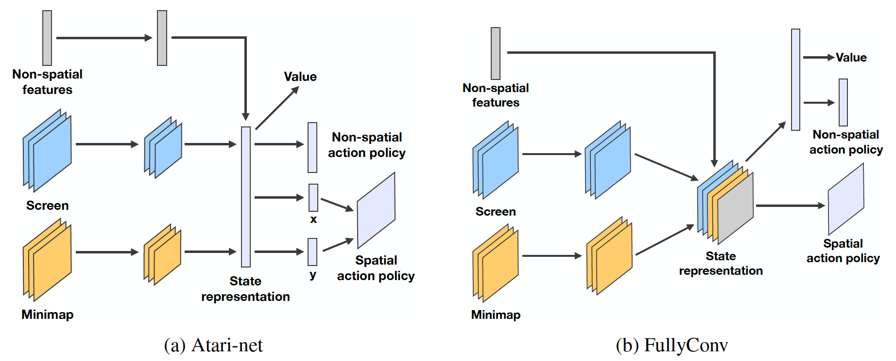
Deepmind Baseline Method [Vinyals et al., 2017]
Policy model
Notes:
在这篇论文中他们使用这两种网络来提取特征和输出动作。他们的输入包括刚才看到的一些图像特征，有前面说到的图像信息，screen信息和minimap信息，以及一些非空间信息。最后，他们输出空间参数比如位置参数和非空间参数，以及动作的价值。

Slide 18
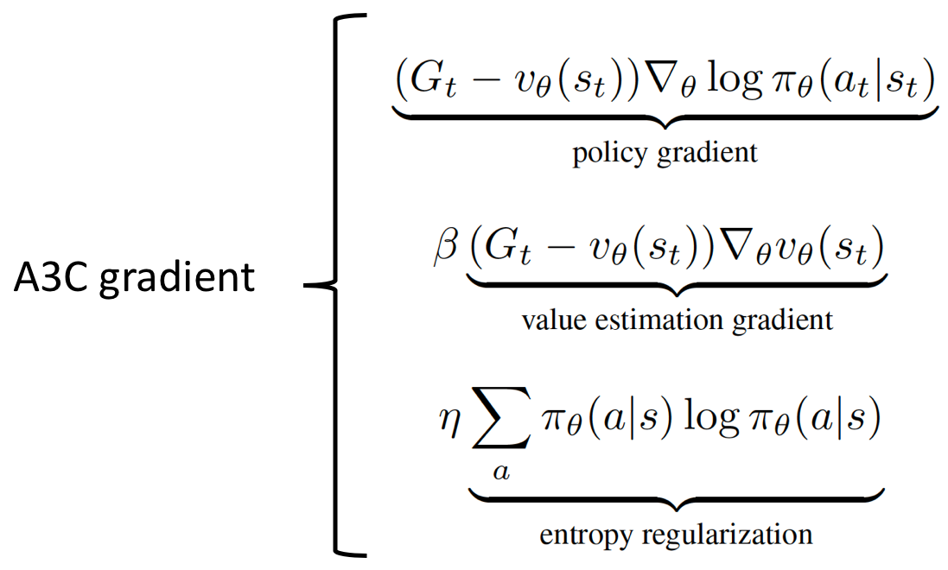
Deepmind Baseline Method [Vinyals et al., 2017]
Learning algorithm
Asynchronous Advantage Actor Critic (A3C)
[Mnih et al, 2016]
Notes:
他们使用A3C的框架训练。AC也就是Actor Critic的框架包含Actor和Critic，前者根据当前的状态计算下一步的动作，Critic则不断更新评判当前动作好坏的值函数。通过这样的不断训练来得到最优策略。A3C是通过多个异步的AC来进行最终模型的更新。

Slide 19
Deepmind Baseline Results [Vinyals et al., 2017]
Map | Deepmind | Human
MoveToBeacon | 26 | 28
CollectMineralShards | 103 | 177
DefeatRoaches | 100 | 215
DefeatZerglingsAndBanelings | 62 | 727
FindAndDefeatZerglings | 45 | 61
CollectMineralsAndGas | 3978 | 7566
BuildMarines | 3 | 133
Notes:
这是Deepmind在7个minigame中的一些结果。可以看到，在一些任务中已经取得了不错的结果。而在其他任务中，比如第2个和第7个任务的表现，距离人类还有不少差距。

Slide 20
Deepmind Baseline Results [Vinyals et al., 2017]
Map | Deepmind | Human
MoveToBeacon | 26 | 28
CollectMineralShards | 103 | 177
DefeatRoaches | 100 | 215
DefeatZerglingsAndBanelings | 62 | 727
FindAndDefeatZerglings | 45 | 61
CollectMineralsAndGas | 3978 | 7566
BuildMarines | 3 | 133

Slide 21
Other Methods
A2C [chris, 2017; pekaalto, 2017; inoryy, 2018; simonmeiste, 2018]
A3C [xhujoy, 2017]
DQN [chris, 2017]
PPO [pekaalto, 2017]
Meta-learning Hierarchies[kafrouni, 2018]
Transfer Learning (Progressive Network) [Aaes et al., 2018]
Notes:
这是目前开源的一些其他方法，包括17年和18年的这些开源的工作。

Slide 22
Partial Results
Map | DeepMind (A3C) | Roman Ring (A2C) | Xhujoy (A3C) | pekaalto |  | Simonmeister (A2C) | Tonybeltramelli (supervised) | Human
 |  |  |  | A2C | PPO
MoveToBeacon | 26 | 26.3 | 25 | 25 | 26 | 26 | 25 | 28
CollectMineralShards | 103 | 106 | 62 | 91 | 100 | 97 | 3 | 177
FindAndDefeatZerglings | 45 | 43 | - | 42 | 45 | 45 | - | 61
DefeatRoaches | 100 | 147 | 87 | 80 | - | 65 | - | 215
DefeatZerglingsAndBanelings | 62 | 230 | - | 48 | - | 68 | - | 727
CollectMineralsAndGas | 3978 | 3340 | - | - | - | - | - | 7566
BuildMarines | 3 | 0.55 | - | - | - | - | - | 133
Notes:
这里是他们的结果，可以看到，表现都没有达到人类标准。

Slide 23
Our Work
Reward Shaping for CollectMineralShards
Hierarchical Modeling for BuildMarines
Other Works
Imitation Learning
Human vs Agents
Notes:
于是我们就想，可不可以在这两个任务中取得一点进步呢？

Slide 24
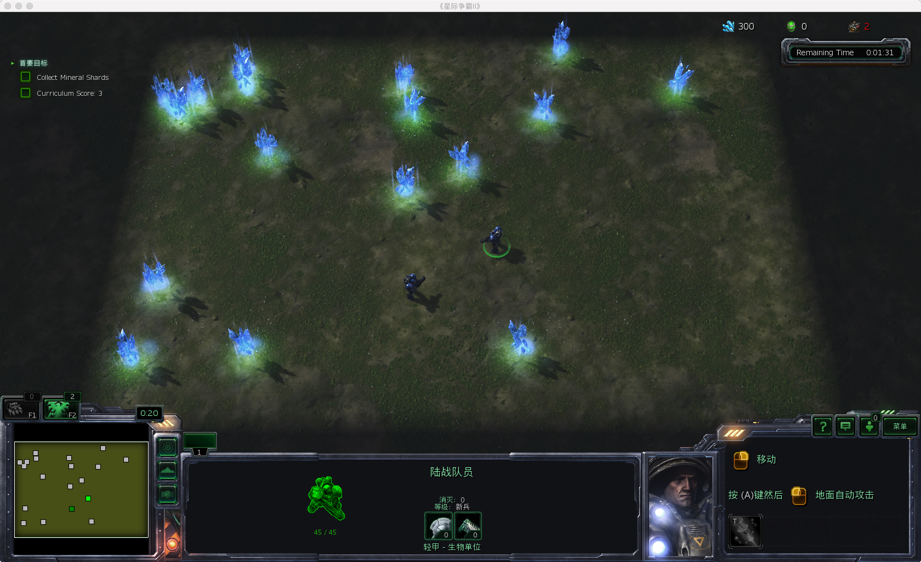
CollectMineralShards
Task description
The agent starts with two marines and must select and move them to pick up mineral shards spread around the map.
Rewards
Marine collects mineral
shards: +1
Time limit
120 seconds
Notes:
Optimal strategy would be to navigate them simultaneously.
Optimal collection requires both Marine units to be split up and moved independently
说明一下比较好的策略是什么

Slide 25
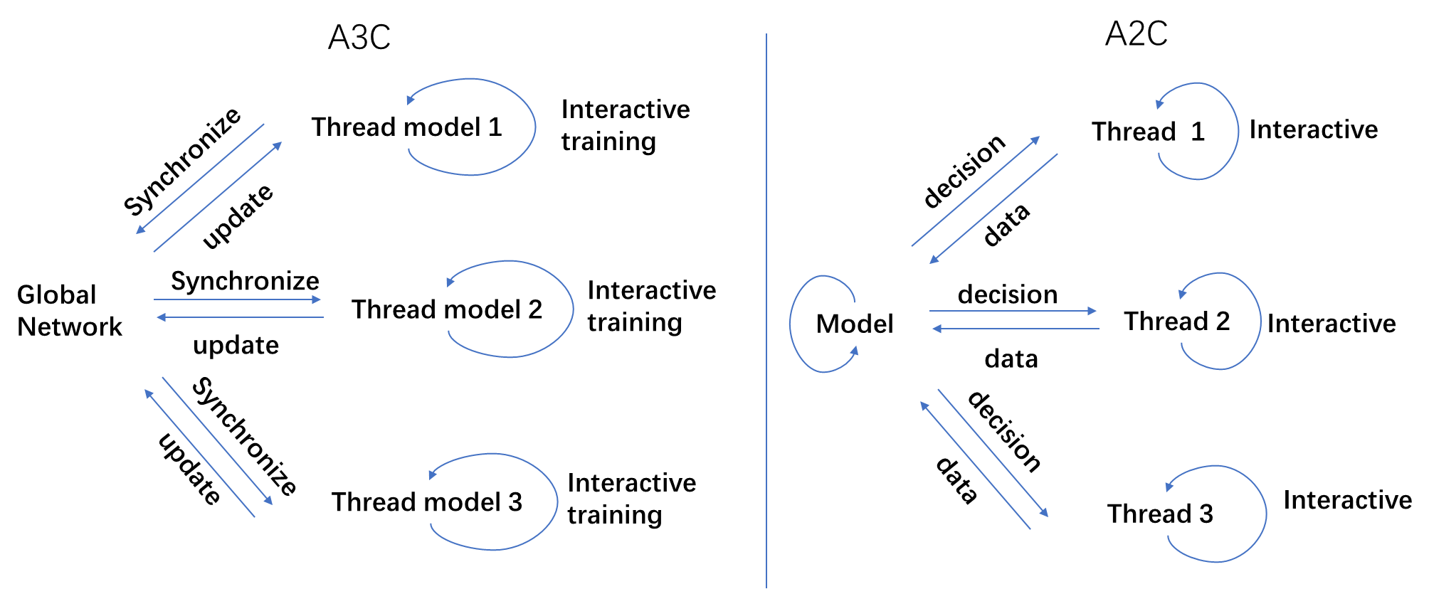
Method
Actor Advantage Critic (A2C) [Wang et al., 2017]
A2C is a synchronous, deterministic variant of Asynchronous Advantage Actor Critic (A3C) which OpenAI has found gives equal performance.
Difference between A2C and A3C
Notes:
首先对于这个minigame，也就是采矿，我们要操控士兵从地图中拾取散落的矿石。每拾得一个矿石，就会获得一个reward也就是1分。在120s中，我们要争取获得更高的分数。

Slide 26
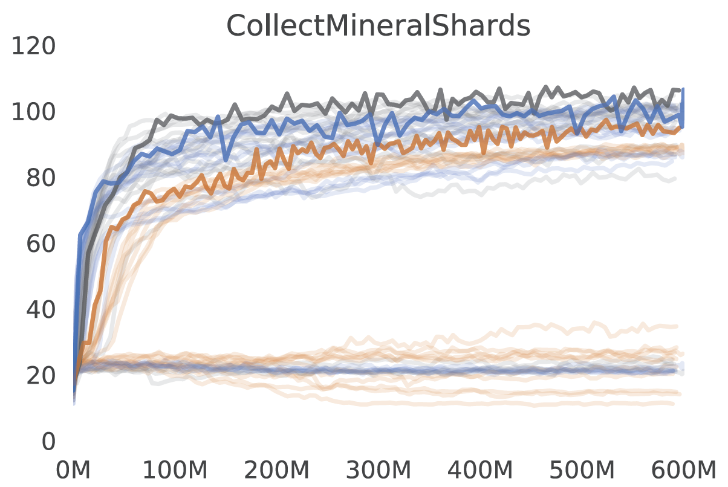
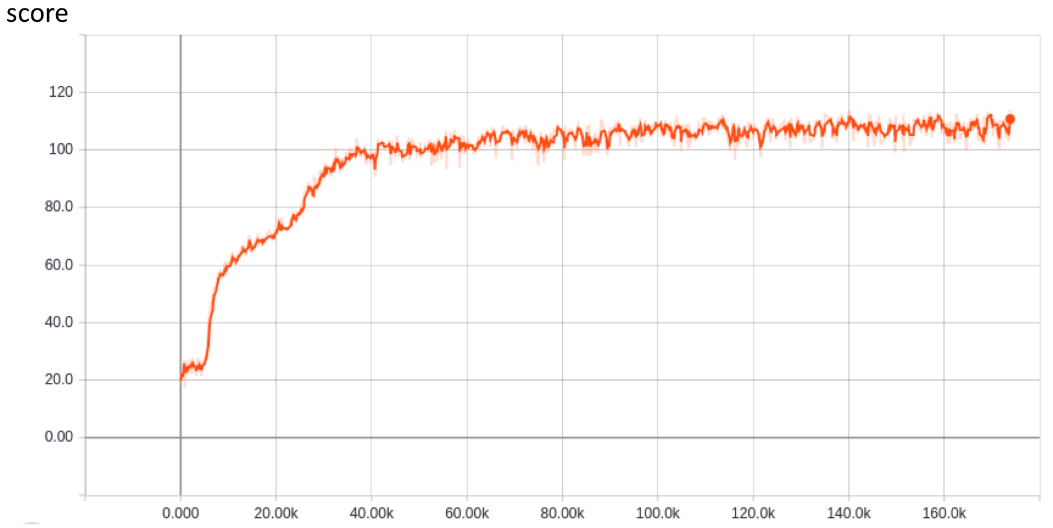
Results
Deepmind (A3C) vs. Our reproduction (A2C)
This agent | Deepmind | Human
106 | 103 | 177
Notes:
我们首先利用A2C框架来复现了Deepmind的工作。A2C和A3C之间的区别就在于同步更新和异步更新。我们可以看到，我们实际上取得和Deepmind差不多的结果。我们先来看下训练的结果。

Slide 27
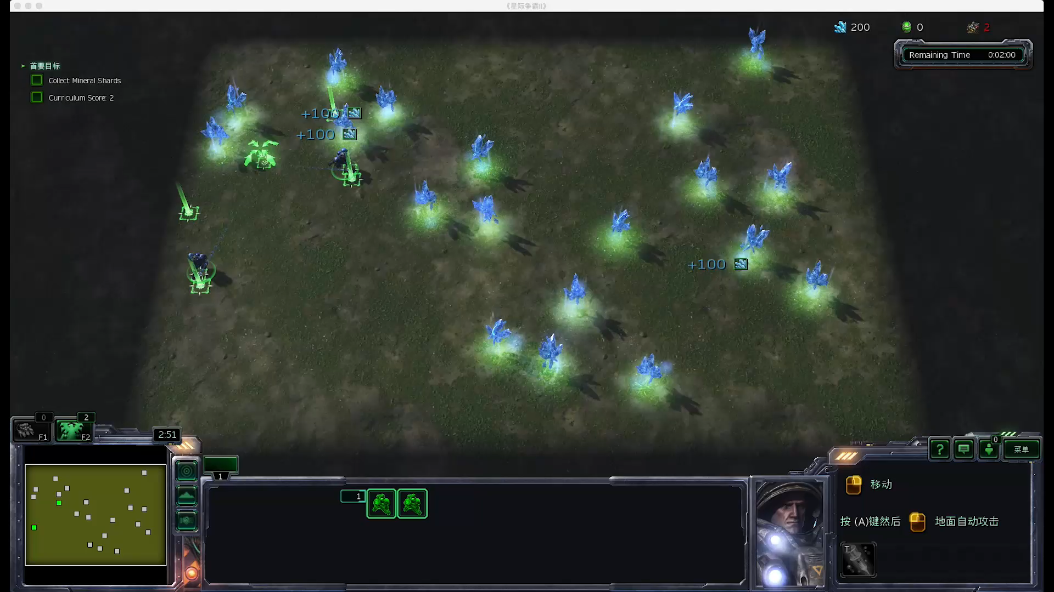
Notes:
放视频。我们可以看到，两个兵相互依偎，一步不离，采集所有矿石。

Slide 28
Result Analysis
Our results match DeepMind baseline results, but are almost two times worse than human experts
Two marines are not split up and moved independently
Possible reason
Original reward (marine collects mineral shards: +1) can’t guide the agent in the right direction
Notes:
我们的结果几乎要比人类水平差两倍。从视频中可不可以看出一些端倪呢？两个兵总是一起行动，既不分开，也不独立。是什么原因导致的呢？我们猜想，当前的reward只有在踩到矿石时，才会获得，因此并不会引导agent向分开的方式发展。

Slide 29
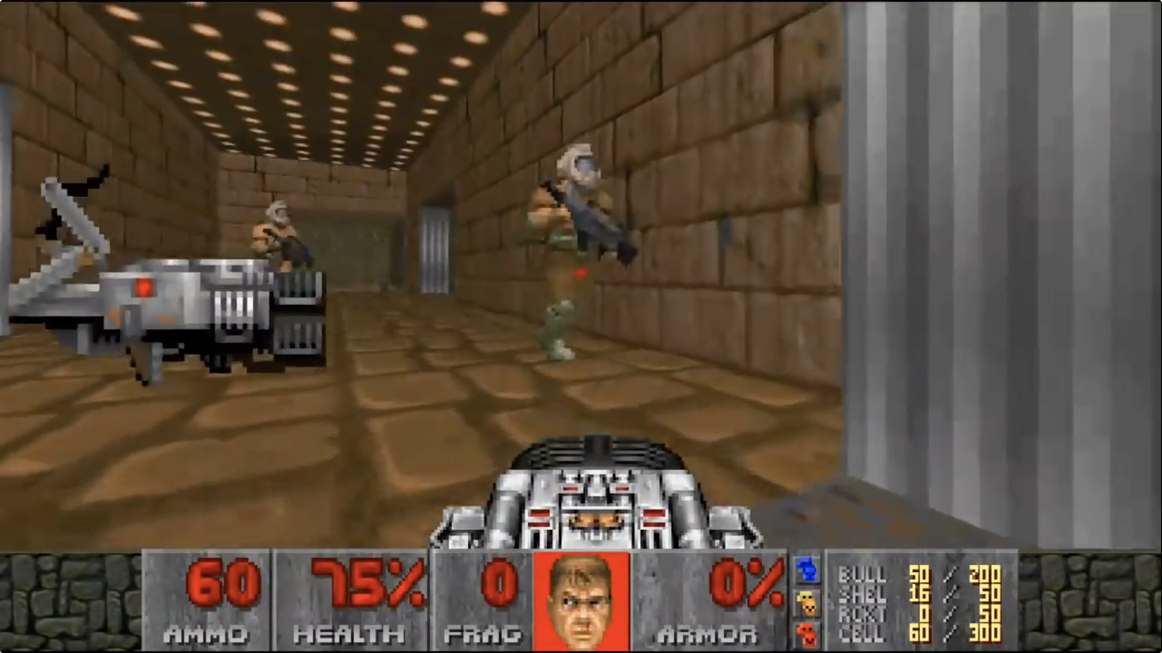
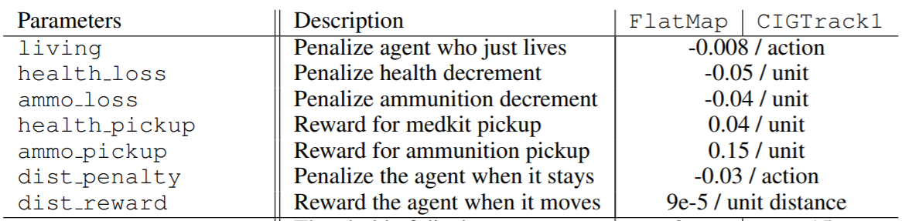
Inspired work
First-person Shooter Game (VizDoom) [Wu et al, 2017]
Win: +1; Draw: 0; Loss: -1
Reward
Notes:
受到wu等人在FPS游戏中的工作的启发，他们将原本的win/lose reward进行了shapping，对不同的动作进行不同的reward反馈，最后取得了很好的效果，也取得了当届比赛的冠军。

Slide 30
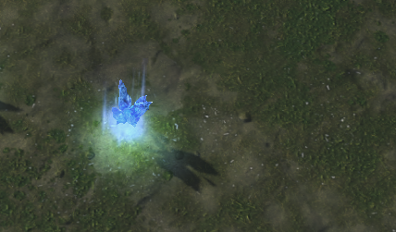
Reward Shaping
Original reward
Notes:
因此，我们也考虑在这个任务中做reward shapping，在原本reward的基础上

Slide 31
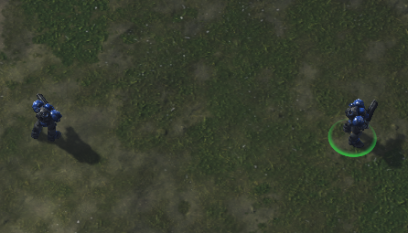
Reward Shaping
+
Original reward
Current reward
Notes:
，我们加入距离的惩罚，来引导两个兵分开。

Slide 32
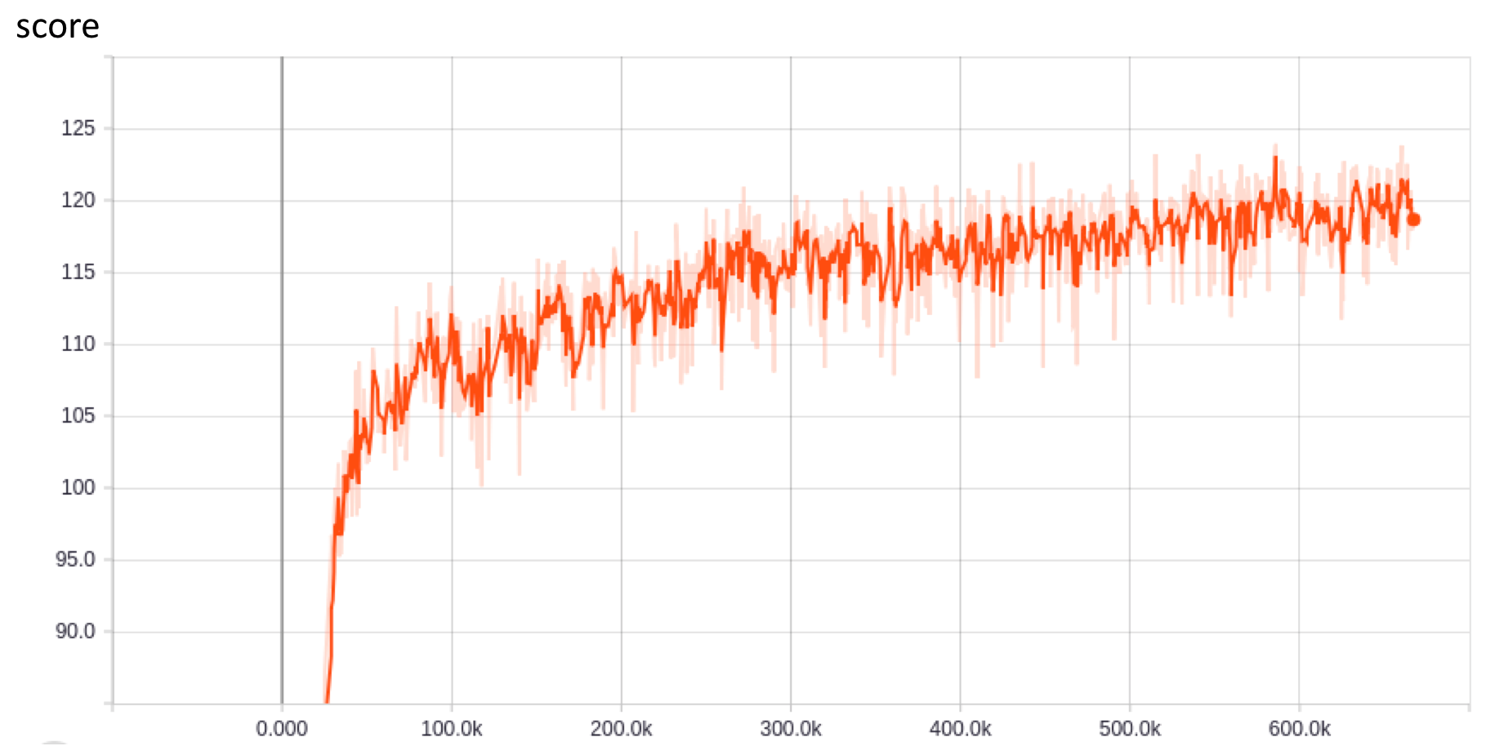
A2C with Reward Shaping
Last agent | Deepmind | Human
106 | 103 | 177
Our agent
120
Notes:
最后，我们确实取得了更好的效果！我们看一下改进后的视频。

Slide 33
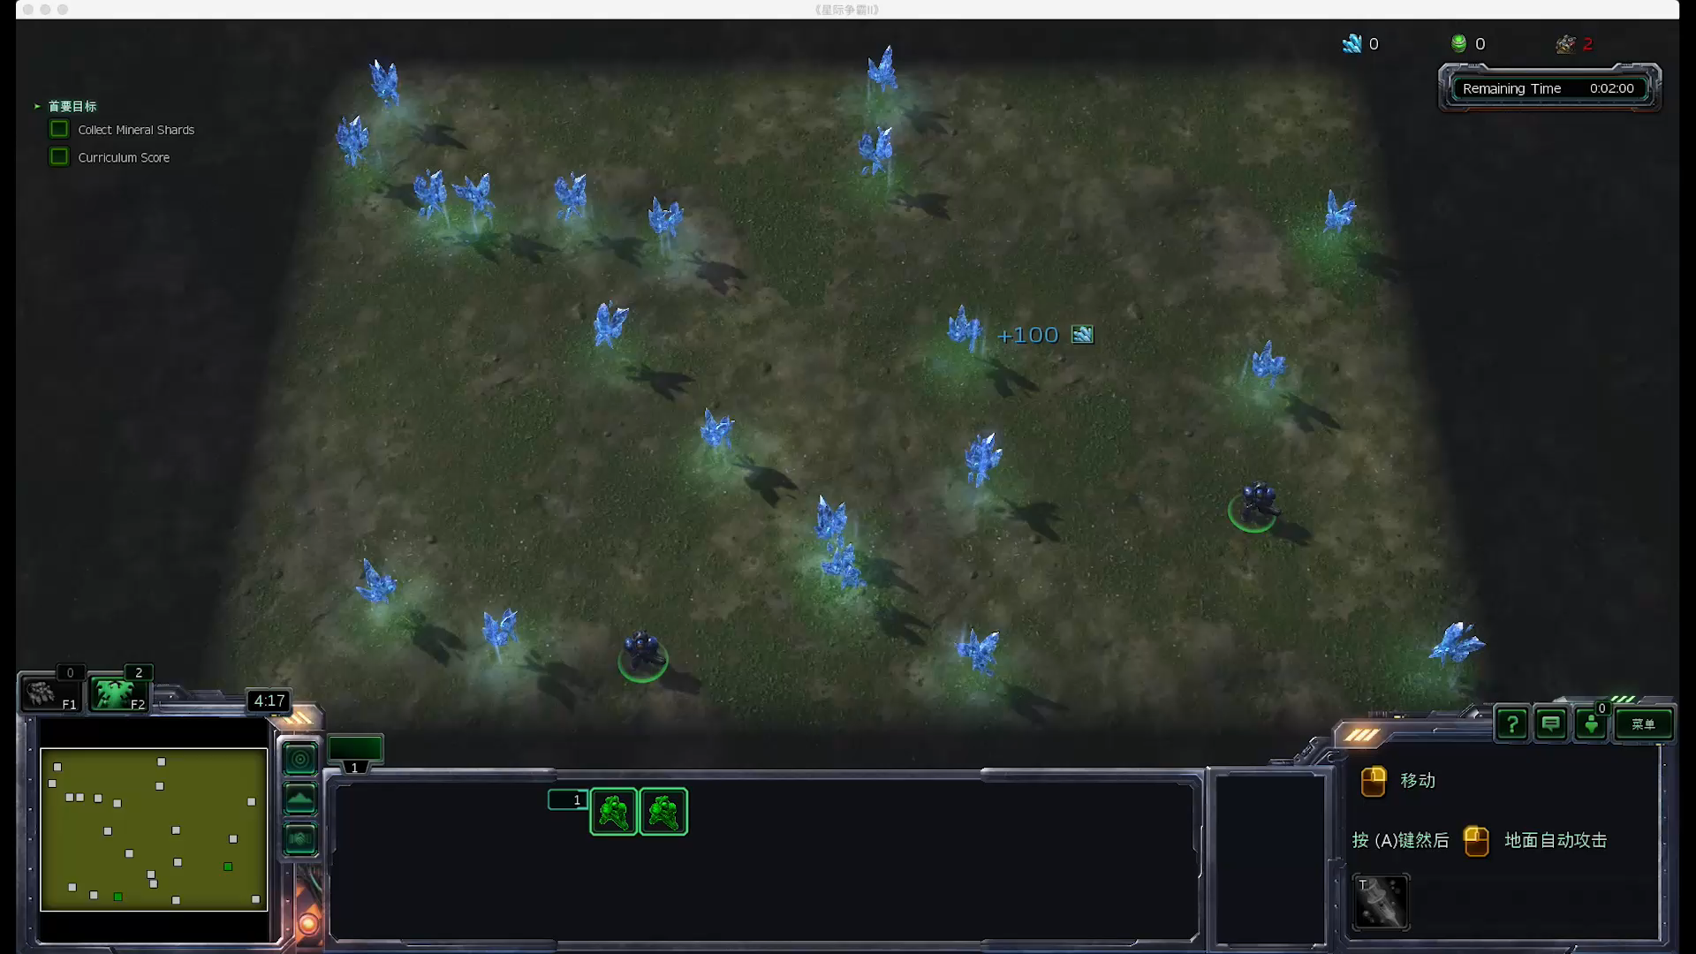
Notes:
指出两个兵的距离

Slide 34
Result Analysis
Better than before
120 (with reward shaping) vs. 106 (without reward shaping)
Two marines are split up, but not moved independently
Keeping some distance between marines makes the results better, even through two marines can’t be moved independently
Notes:
Optimal strategy would be to navigate them simultaneously.
Optimal collection requires both Marine units to be split up and moved independently

Slide 35
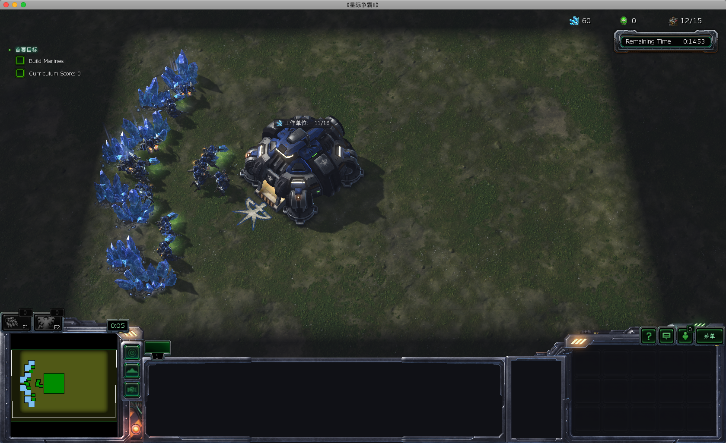
BuildMarines
Task description
The agent starts with a limited base and is rewarded for building marines.
Rewards
Build a marine: +1
Time limit
900 seconds

Slide 36
BuildMarines
Task description
The agent starts with a limited base and is rewarded for building marines.
Rewards
Build a marine: +1
Time limit
900 seconds
Hard!!!
Notes:
难！为什么难？下一页

Slide 37
Why hard?
Multiple sub-tasks
It must build workers, collect resources, build Supply Depots, build Barracks, and then train marines.
It requires completion of multiple sub-tasks with long time-steps in between.
Sparse reward & Delayed reward
Only get reward when the marines are built.
A2C agent | Deepmind | Human
0.5 | 3 | 133

Slide 38
Bad Results Reason Analysis
Huge action space
524 action functions + 13 parameter types -> 101938719 possible actions
Sparse reward
Hard to build marine with low-level actions exploration.
Notes:
动作空间大：动作 + 动作参数
层级化的动作
---
现在是底层的动作

Slide 39
Bad Results Reason Analysis
Huge action space
524 action functions + 13 parameter types -> 101938719 possible actions
Sparse reward
Hard to build marine with low-level actions exploration.
build workers -> collect resources -> build Supply Depots -> build Barracks -> train marines
Notes:
动作空间大：动作 + 动作参数
层级化的动作
---
现在是底层的动作

Slide 40
Bad Results Reason Analysis
Huge action space
524 action functions + 13 parameter types -> 101938719 possible actions
Sparse reward
Hard to build marine with low-level actions exploration.
build workers -> collect resources -> build Supply Depots -> build Barracks -> train marines
(0.01 * 0.02 * …)
Notes:
动作空间大：动作 + 动作参数
层级化的动作
---
现在是底层的动作

Slide 41
Bad Results Reason Analysis
Huge action space
524 action functions + 13 parameter types -> 101938719 possible actions
Sparse reward
Hard to build marine with low-level actions exploration.
build workers -> collect resources -> build Supply Depots -> build Barracks -> train marines
(0.01 * 0.02 * …)
* (0.01 * 0.02 * 0.03 * …)
Notes:
动作空间大：动作 + 动作参数
层级化的动作
---
现在是底层的动作

Slide 42
Bad Results Reason Analysis
Huge action space
524 action functions + 13 parameter types -> 101938719 possible actions
Sparse reward
Hard to build marines with low-level actions exploration.
build workers -> collect resources -> build Supply Depots -> build Barracks -> train marines
(0.01 * 0.02 * …)
* (0.01 * 0.02 * 0.03 * …)
…
Notes:
动作空间大：动作 + 动作参数
层级化的动作
---
现在是底层的动作

Slide 43
Our Intuition
Our task
Build marines as much as possible
Master vs. freshman
Basic skill (low-level)
Build workers, collect resources, build Supply Depots, build Barracks, train marines (relatively fixed)
Scheduling strategy ability (high-level)
Given current game state, choose a basic skill to execute (different)

Slide 44
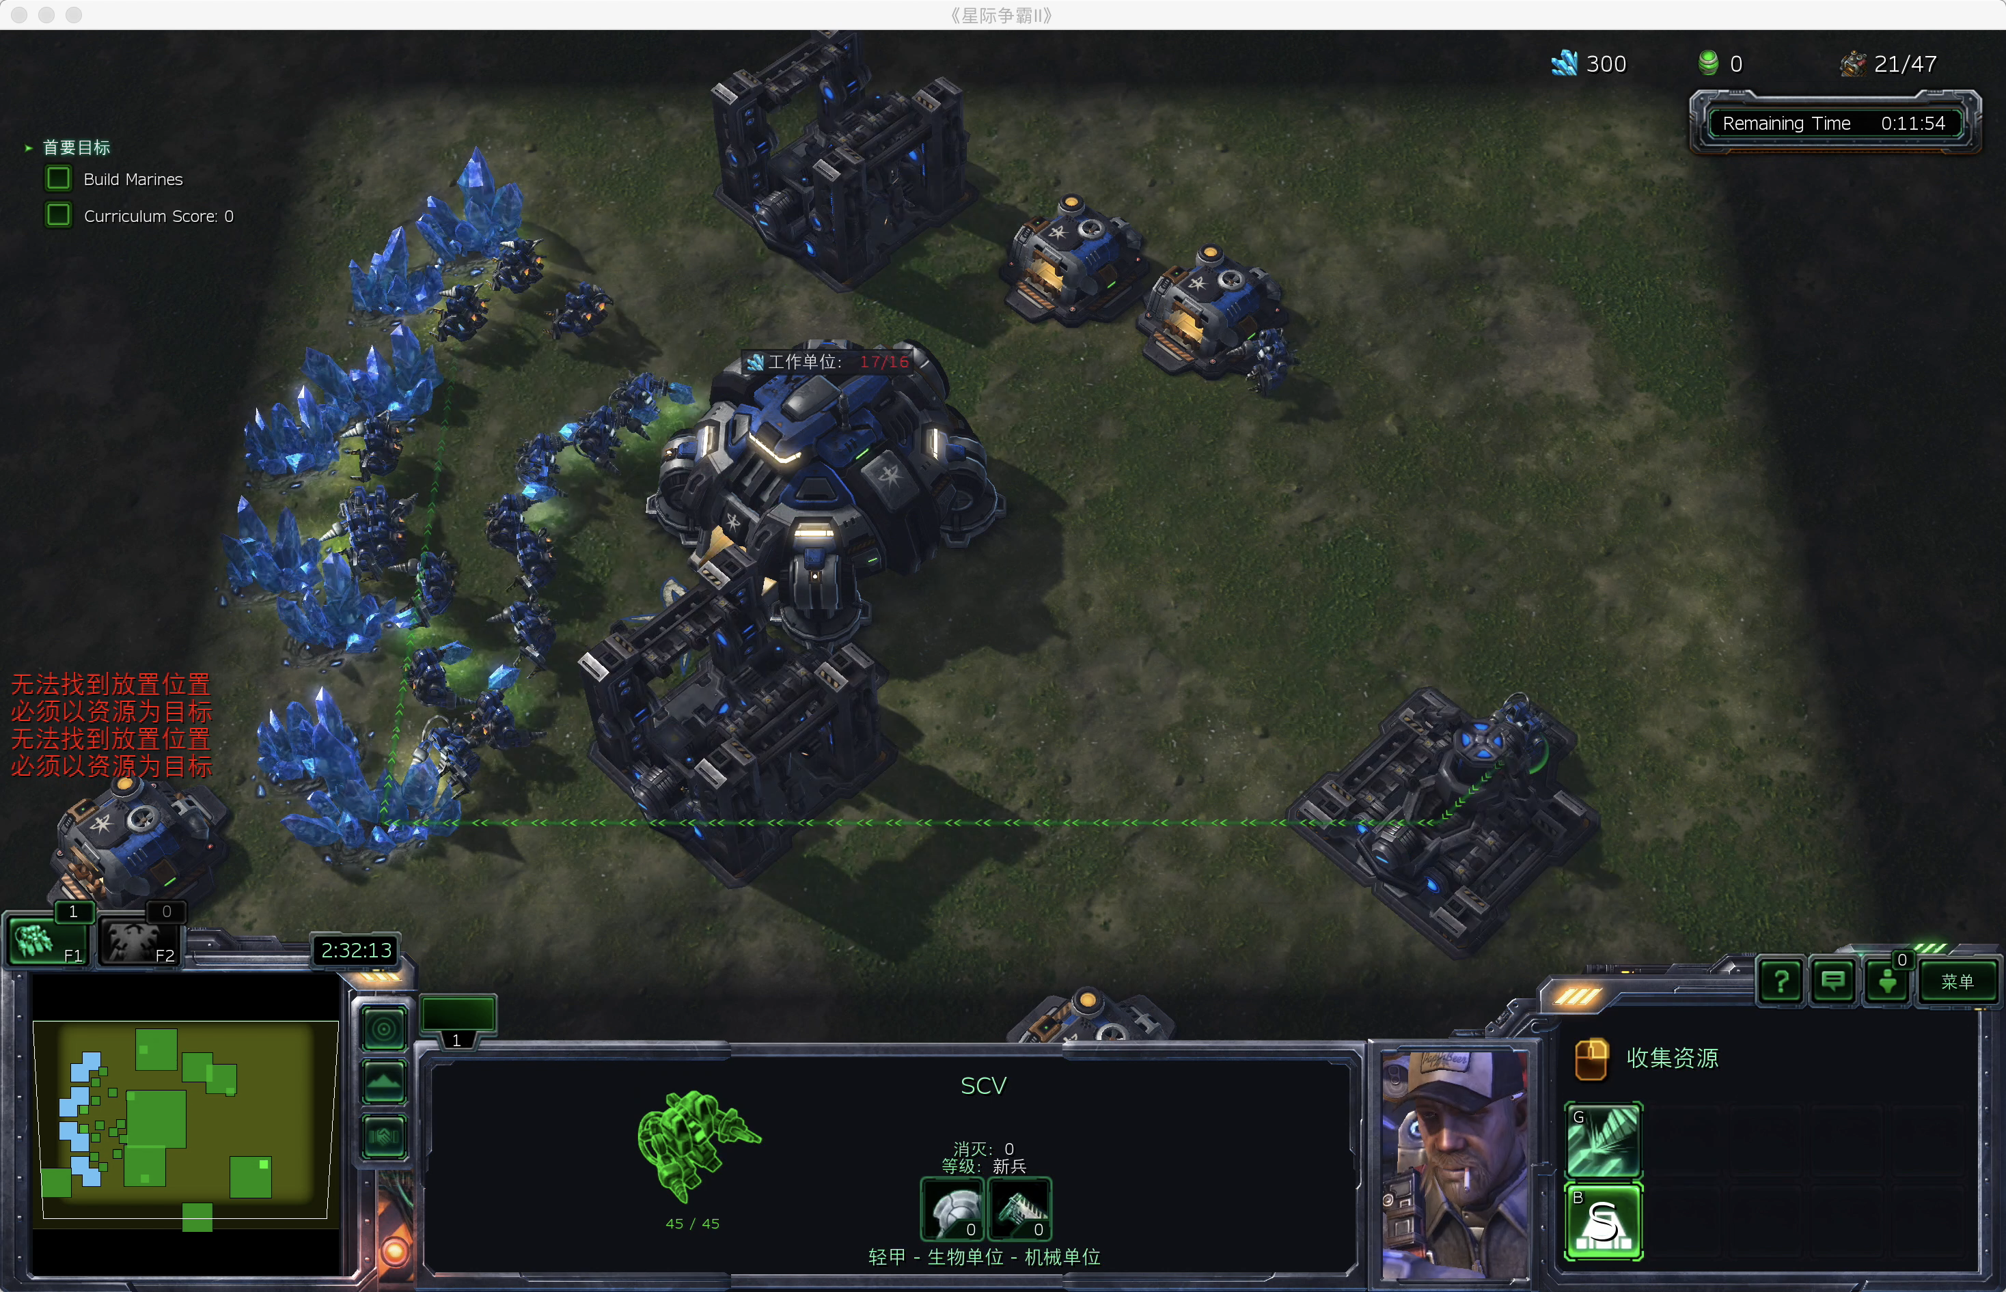
Build Workers
Collect Resources
Build Supply Depots
Build Barracks
Train Marines

Slide 45
Our Intuition
Our task
Build marines as much as possible
Master vs. freshman
Basic skill (low-level)
Build workers, collect resources, build Supply Depots, build Barracks, train marines (relatively fixed)
Scheduling strategy ability (high-level)
Given current game state, choose a basic skill to execute (different)

Slide 46
Our Intuition
Our task
Build marines as much as possible
Master vs. freshman
Basic skill (low-level)
Build workers, collect resources, build Supply Depots, build Barracks, train marines (relatively fixed)
Scheduling strategy ability (high-level)
Given current game state, choose a basic skill to execute (different)
Learning from scratch is hard
Especially for the hierarchical tasks

Slide 47
Our Intuition
Our task
Build marines as much as possible
Master vs. freshman
Basic skill (low-level)
Build workers, collect resources, build Supply Depots, build Barracks, train marines (relatively fixed)
Scheduling strategy ability (high-level)
Given current game state, choose a basic skill to execute (different)
Learning from scratch is hard
Especially for the hierarchical tasks
Rule-based
Learning-based

Slide 48
Hierarchical Modeling for BuildMarines
Do nothing
do nothing for 3 steps
Build SCV
select command center, train SCV, send SCV to harvest minerals
Build Supply Depot
select SCV, build supply depot, send SCV to harvest minerals
Build Barrack
select SCV, build barrack, send SCV to harvest minerals
Build marine
select all barracks, train marine, do nothing

Slide 49
Hierarchical Modeling for BuildMarines
Do nothing
do nothing for 3 steps
Build SCV
select command center, train SCV, send SCV to harvest minerals
Build Supply Depot
select SCV, build supply depot, send SCV to harvest minerals
Build Barrack
select SCV, build barrack, send SCV to harvest minerals
Build marine
select all barracks, train marine, do nothing
Try to learn a high-level strategy scheduling

Slide 50
State space
Supply Depot Count
Army Count
Food Left
Barracks Count
Collect Minerals

Slide 51
Learning Framework
Low-level models
More aware of particulars
Captures variability
Step1 -----
Step2 -----
Step3 -----
Step1 ---- Step2 ----
Step3 ----
……
High-level actions
More aware of global task
Generalizes
1
2
3
4
5
Actions
DQN / Q-Learning
Agent
Starcraft Environment
Do nothing
Build SCV
Build Supply Depot
Build Barrack
Build marine
Observation
Reward

Slide 52
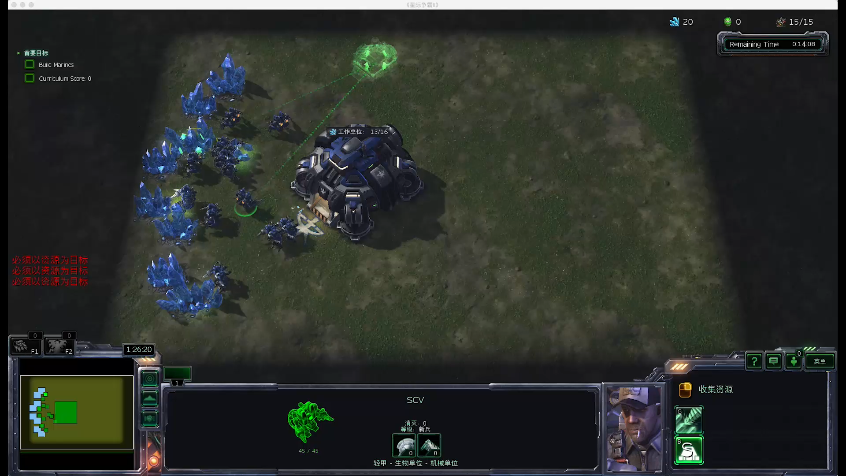
Last agent | Deepmind | Human
0.5 | 3 | 133
Our agent
95

Slide 53
Result Analysis
Combine rule-based method (Low-level) with learning-based method (High-level) is a good way to learn hierarchical strategic tasks.
Possible reasons for the gap between our agent and human
Invalid Actions
Positions to Build Supply Depots or Barracks
Now are randomly chosen
Which SCV to select
Now is randomly chosen
Delayed Rewards
It may need steps to train an unit
Last agent | Deepmind | Human
0.5 | 3 | 133
Our agent
95

Slide 54

How to Transfer
Low-level models
More aware of particulars
Captures variability
Step1 -----
Step2 -----
Step3 -----
Step1 ---- Step2 ----
Step3 ----
……
High-level actions
More aware of global task
Generalizes
1
2
3
4
5
Actions
DQN / Q-Learning
Agent
Starcraft Environment
Do nothing
Build SCV
Build Supply Depot
Build Barrack
Build marine
Observation
Reward

Slide 55
Future Work
Low-level Policies: Rule-based -> Learning-based
Delayed Rewards in StarCraft II

Slide 56
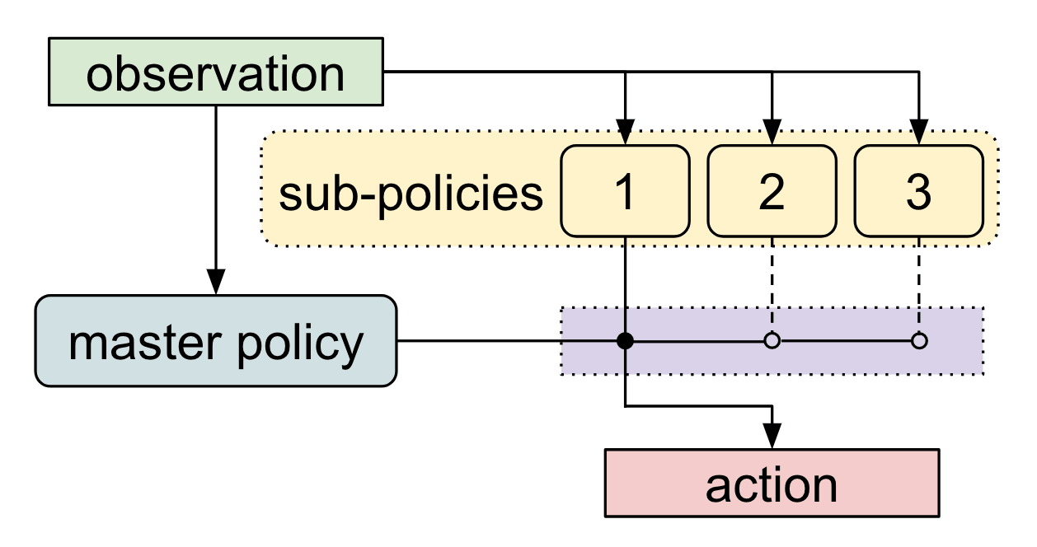
Low-level policies: Rule-based -> Learning-based
Meta Learning Shared Hierarchies [Frans et al., 2017]

Slide 57
Delayed Rewards in StarCraft II
Learning by Playing (Riedmiller et al., 2018)
Return Decomposition for Delayed Rewards (Arjona-Medina et al., 2018)

Slide 58
Conclusion
Reinforcement Learning -> Why StarCraft II? -> StarCraft Minigames
Previous Works
Deepmind & Others
Our Work
Reward Shaping for CollectMineralShards
Hierarchical Modeling for BuildMarines
Future Work
Low-level Policies: Rule-based -> Learning-based
Delayed Rewards in StarCraft II
Notes:
今天讲了什么？

Slide 59






Thanks All!
Wang Yuchen 王宇辰
Dai Wei 戴 玮
Du Zhonghui 杜仲辉
Liu Minghuan 刘明桓
Liu Tianlin 刘天林
Meng Fanyue 孟繁悦
Ren Yuzheng 任语铮
Wang Xian 王 贤
Wei Xing 魏 兴
Xiao Xingyu 肖星宇

Slide 60












Reference
https://github.com/Inoryy/pysc2-rl-agent
https://github.com/XHUJOY/pysc2-agents
https://github.com/chris-chris/pysc2-examples
https://github.com/pekaalto/sc2aibot
https://github.com/simonmeister/pysc2-rl-agents
https://github.com/tonybeltramelli/Supervised-End-to-end-Weight-sharing-for-StarCraft-II
Notes:
现状

Slide 61
Reference
[1] Vinyals O, Ewalds T, Bartunov S, et al. Starcraft ii: A new challenge for reinforcement learning[J]. arXiv preprint arXiv:1708.04782, 2017. (DeepMind & Blizzard)
[2] Ring R. Replicating DeepMind StarCraft II reinforcement learning benchmark with actor-critic methods[J]. 2018.
[3] Pathak D, Agrawal P, Efros A A, et al. Curiosity-driven exploration by self-supervised prediction[C]. International Conference on Machine Learning (ICML). 2017, 2017.
[4] Jaderberg M, Mnih V, Czarnecki W M, et al. Reinforcement learning with unsupervised auxiliary tasks[J]. arXiv preprint arXiv:1611.05397, 2016.
[5] Frans K, Ho J, Chen X, et al. Meta learning shared hierarchies[J]. arXiv preprint arXiv:1710.09767, 2017.
[6] Kulkarni T D, Narasimhan K, Saeedi A, et al. Hierarchical deep reinforcement learning: Integrating temporal abstraction and intrinsic motivation[C] Advances in neural information processing systems. 2016: 3675-3683.
[7] Held D, Geng X, Florensa C, et al. Automatic goal generation for reinforcement learning agents[J]. arXiv preprint arXiv:1705.06366, 2017.
[8] Florensa C, Held D, Wulfmeier M, et al. Reverse curriculum generation for reinforcement learning[J]. arXiv preprint arXiv:1707.05300, 2017.
[9] Andrychowicz M, Wolski F, Ray A, et al. Hindsight experience replay[C]Advances in Neural Information Processing Systems. 2017: 5048-5058.
Notes:
现状

Slide 62

Reference
Learning a Hierarchy (OpenAI Blog)
StarCraft II RL Tutorial 1: StarCraft II RL Tutorial 1
StarCraft II RL Tutorial 2: Deepmind's pysc2: Observations
OpenAI发布8个仿真机器人环境和HER实现：可用于训练
Blog: Ingredients for Robotics Research
Blog: Learning from mistakes with Hindsight Experience Replay
Notes:
现状

